Slide 1

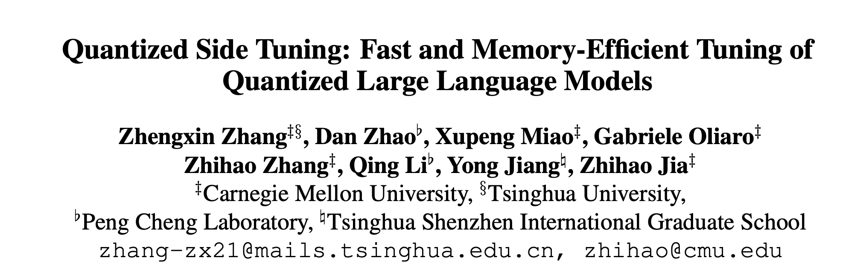

Slide 2
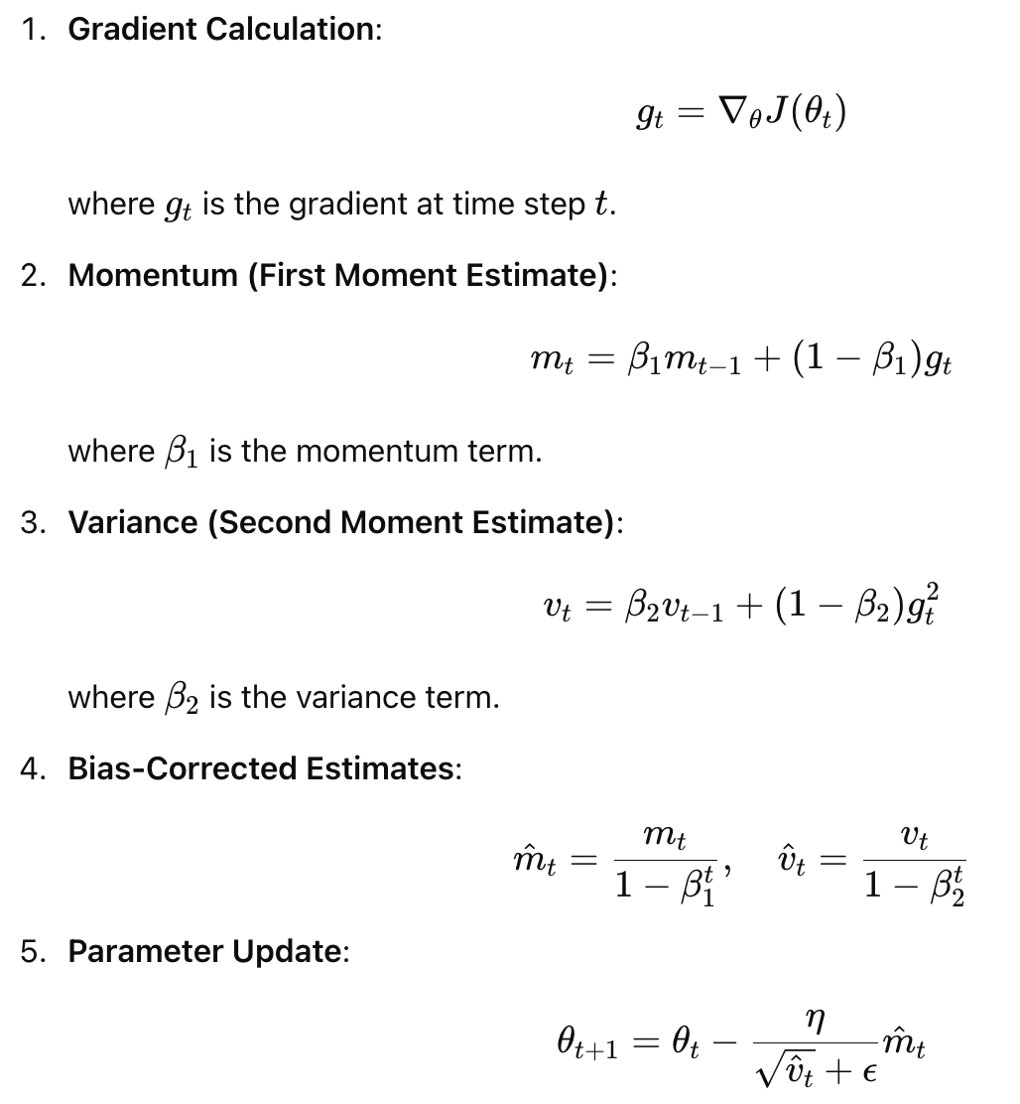
Context: Fine-tuning large language models (LLMs) for downstream tasks is memory-intensive.
For instance, finetuning a 16-bit LLaMA model with 65 billion parameters requires more than 780GB of memory,10x NVIDIA A100 GPU (80 GB)
Three critical components involved during fine-tuning:
Model Weights: parameters of the model that need to be adjusted
Optimizer States: Optimizers like Adam track additional states for each parameter
Intermediate Activations: During the forward and backward passes of training, activations from each layer must be stored temporarily

Slide 3
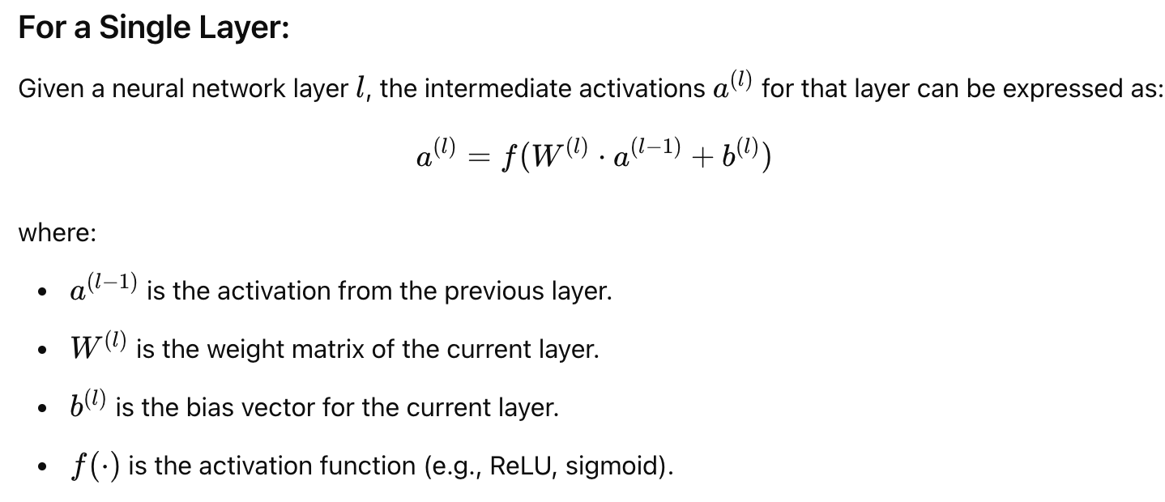
Three critical components involved during fine-tuning:
Model Weights: parameters of the model that need to be adjusted
Optimizer States: Optimizers like Adam track additional states for each parameter
Intermediate Activations: During the forward and backward passes of training, activations from each layer must be stored temporarily

Slide 4
Motivation: Existing methods are either parameter-efficient or reduce memory during training, but not both.
PEFT (parameter-efficient finetuning): updates a subset of trainable parameters or introduces a small number of new parameters
caching intermediate activations during forward processing
PEFT methods require saving more than 70% of activations and almost the same training time compared to full finetuning
QLoRA (quantized low rank adaptation) quantizes an LLM’s weights to 4-bit and leverages low-rank adaption (LoRA)
does not consider the memory footprint of intermediate activations
only supports small-batch training (e.g. a batch size of 1)
LST (Ladder side-tuning): use a side network for intermediate activations by avoiding backpropagation of the LLM
Even with the adoption of a side network, the inherent model size of the LLM remains a challenge.
focus on small models (i.e., less than 3 billion parameters
Solution: Quantized Side Tuning (QST) aims to address these challenges by reducing memory footprints in all three areas.

Slide 5
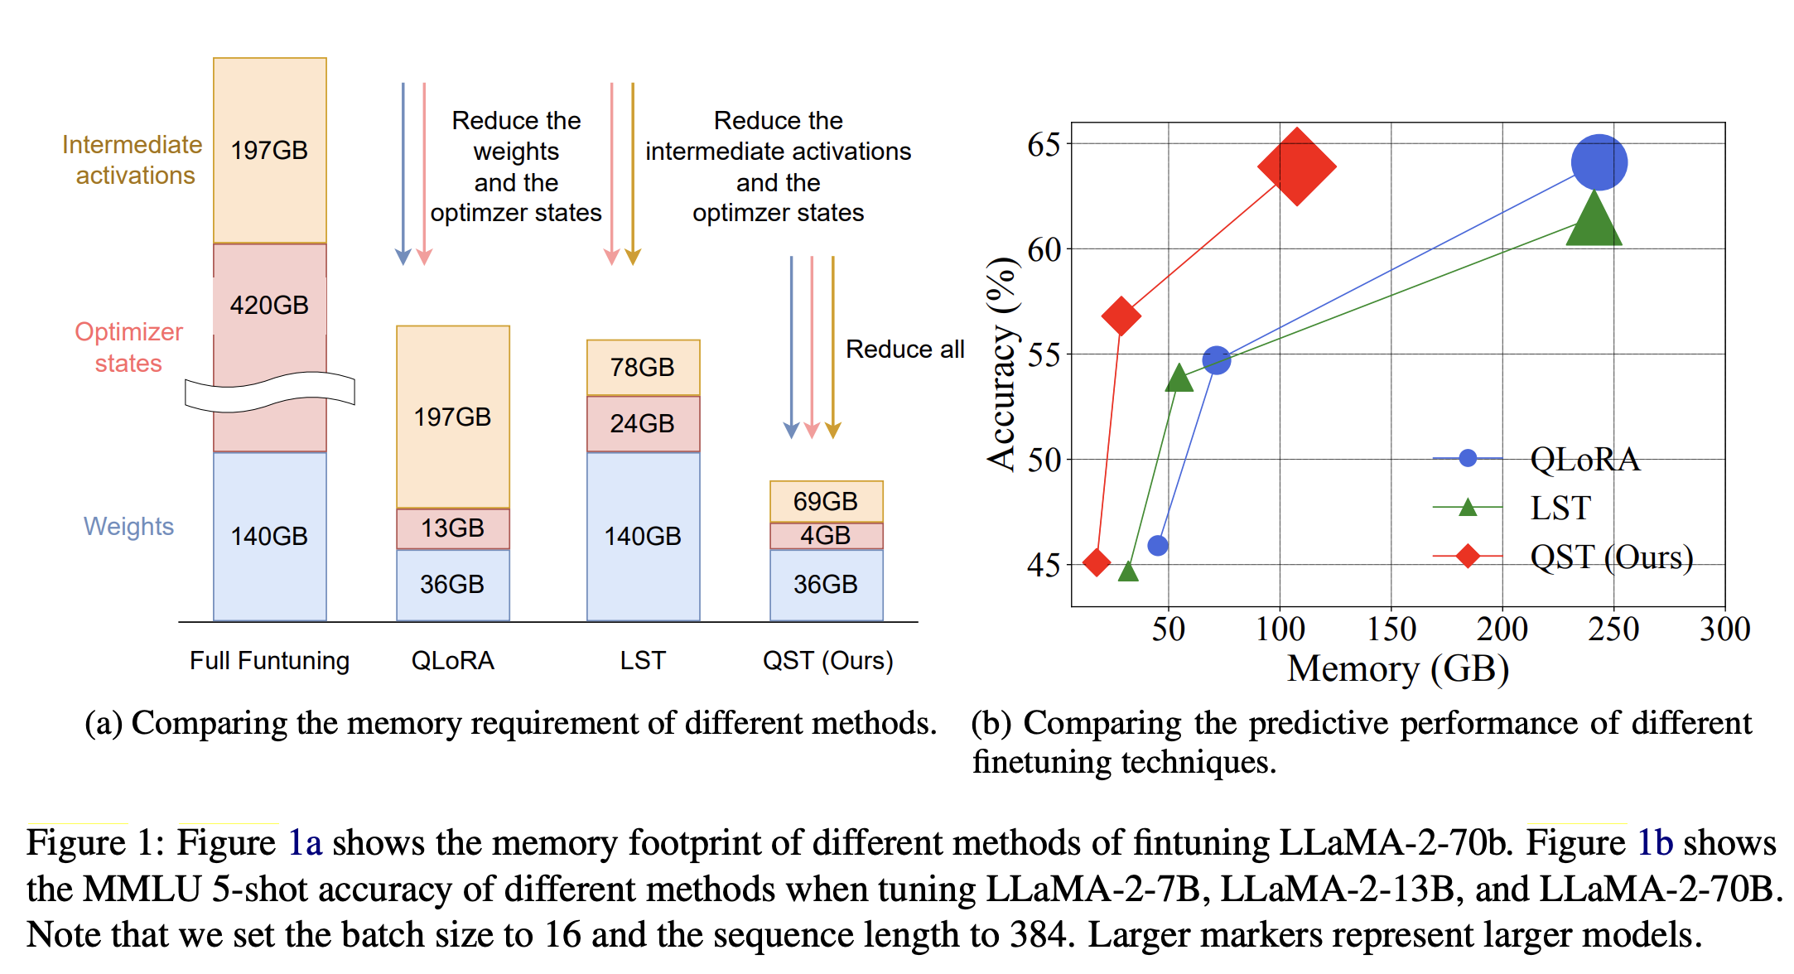

Slide 6
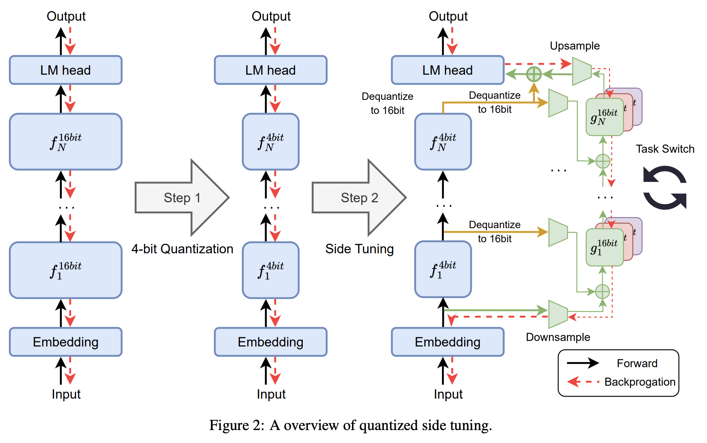
Dual-Stage Process:
4-bit Quantization: Reduces memory footprint of model weights.
Side Network: Avoids backpropagation through the main LLM, reducing memory for intermediate activations.
Memory Efficiency: Reduces memory requirements for weights, optimizer states, and intermediate activations.
Speed: Speeds up the fine-tuning process.
Performance: Maintains competent performance compared to state-of-the-art methods.

Slide 7
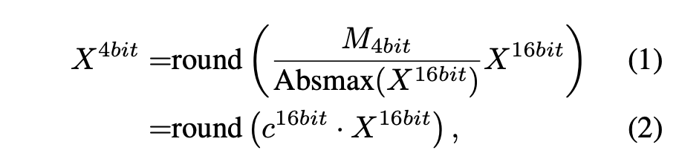
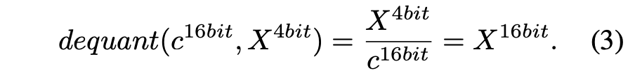
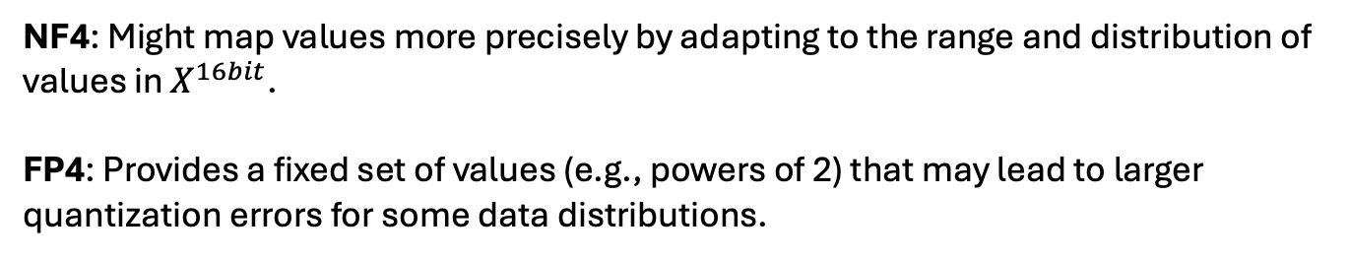
4-bit Quantization: Reduces memory footprint of model weights.
Outliers (X) result in under-utilization of the quantization bins -> sparsely populated or even empty bins -> partitioning the input tensor into discrete blocks, each subjected to independent quantization with its own associated quantization constant
NF4: Might map values more precisely by adapting to the range and distribution of values in $X^{16bit}​$.
FP4: Provides a fixed set of values (e.g., powers of 2) that may lead to larger quantization errors for some data distributions.
use 8-bit float points to quantize the quantization constants

Slide 8
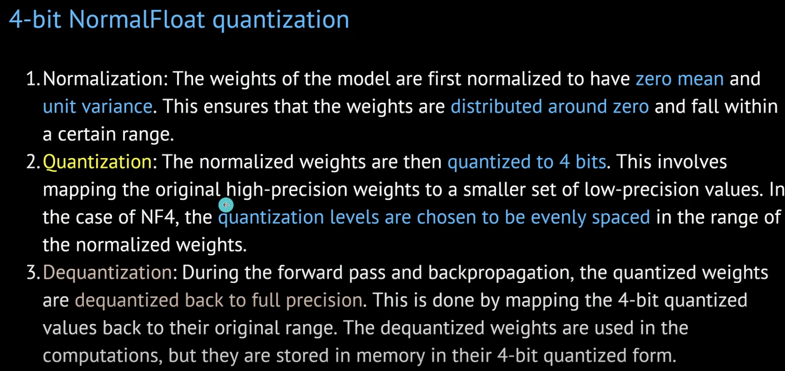

Slide 9
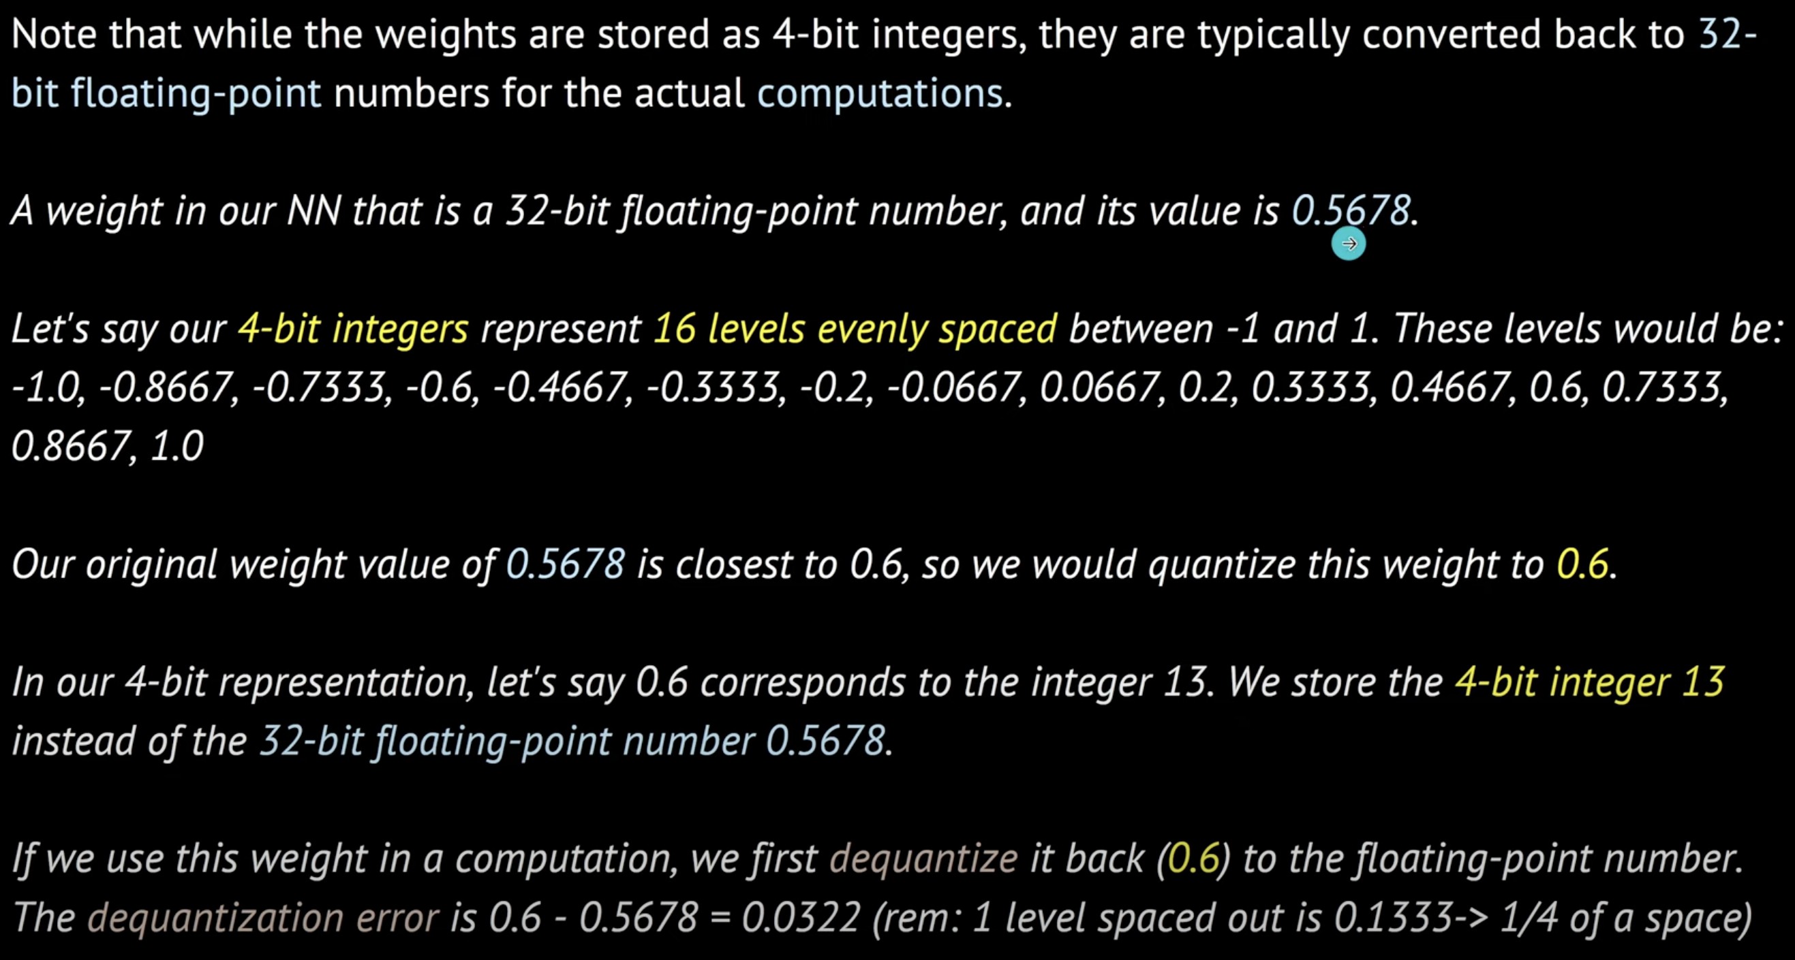

Slide 10
4-bit Quantization: Reduces memory footprint of model weights.
Outliers: partitioning the input tensor into discrete blocks, each subjected to independent quantization with its own associated quantization constant
use 8-bit float points to quantize the quantization constants

Slide 11
4-bit Quantization: Reduces memory footprint of model weights.
Constant: use 8-bit float points to quantize the quantization constants

Slide 12
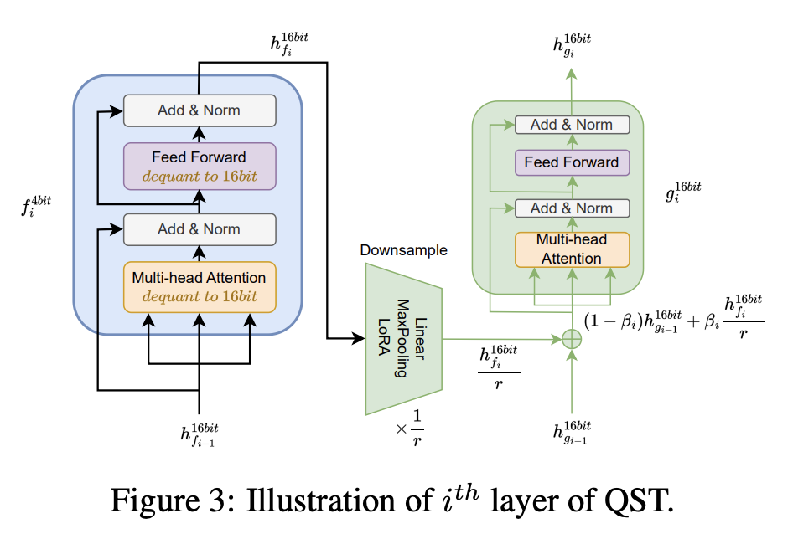
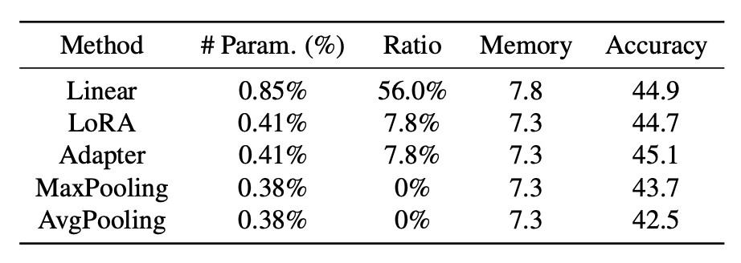
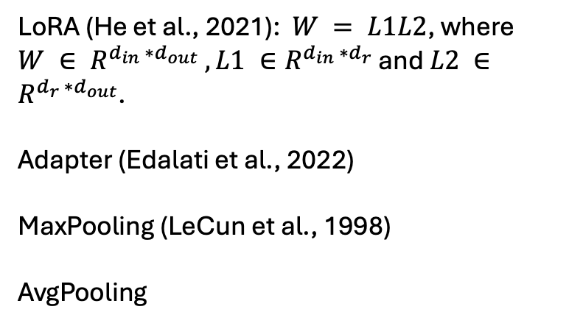
Side Network Design:
Uses the hidden states of the LLM.
Downsamples and upsamples to minimize trainable parameters.
Gate Parameter:Learns to balance contributions from the main LLM and the side network.
LoRA (He et al., 2021): $W = L1L2$, where $W ∈ R^{d_{in} ∗d_{out}} , L1 ∈R^{d_{in} ∗d_{r}}$ and $L2 ∈R^{d_{r} ∗d_{out}}$.
Adapter (Edalati et al., 2022)
MaxPooling (LeCun et al., 1998)
AvgPooling

Slide 13
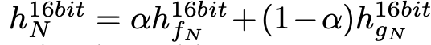
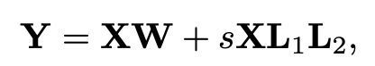
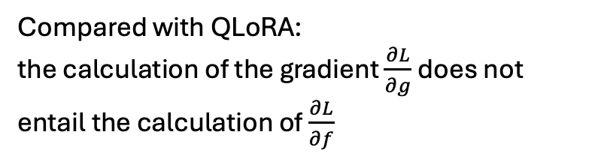
Side Network Design:
Uses the hidden states of the LLM.
Downsamples and upsamples to minimize trainable parameters.
Gate Parameter:Learns to balance contributions from the main LLM and the side network.
Compared with LST:
suffers from repetition when generating long-sequence texts
MEFT (Liao et al., 2023), the initialization step emerges as a critical factor influencing the efficacy of fine-tuning methods.
Compared with QLoRA:
the calculation of the gradient $\frac{∂L}{∂g}$does not entail the calculation of $\frac{∂L}{∂f}$

Slide 14
Datasets: GLUE (Wang et al., 2018) (General Language Understanding Evaluation) and MMLU (Hendrycks et al., 2020) (Massively Multitask Language Understanding) benchmarks
Models: OPT series (OPT-1.3B, OPT-2.7B, OPT-6.7B, OPT13B, OPT-30B, and OPT-66B) and the LLaMA-2 series (LLaMA-2-7B, LLaMA-2-13B, and LLaMA-2-70B).
Baselines. QLoRA (Dettmers et al., 2023), LST (Sung et al., 2022), LoRA (He et al., 2021), and Adapter (Houlsby et al., 2019).

Slide 15
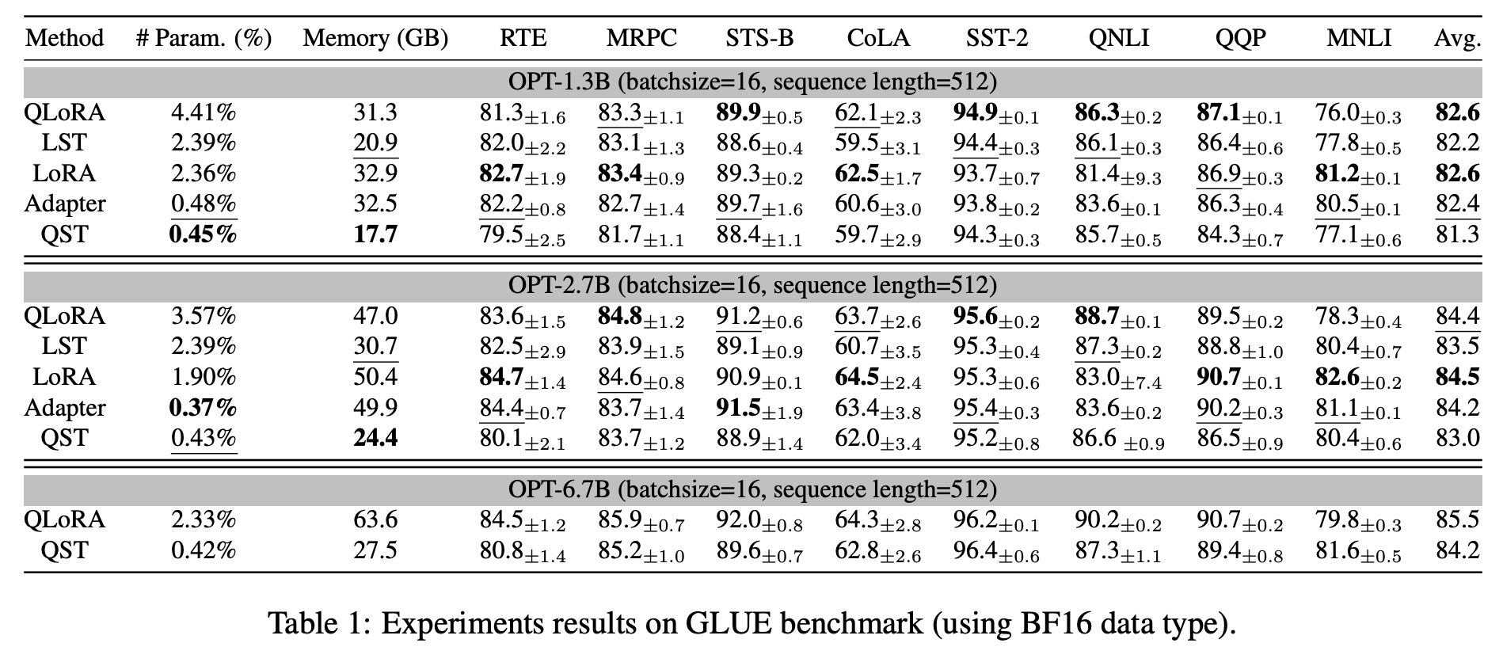

Slide 16
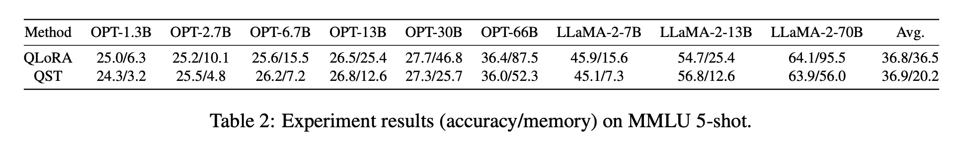

Slide 17
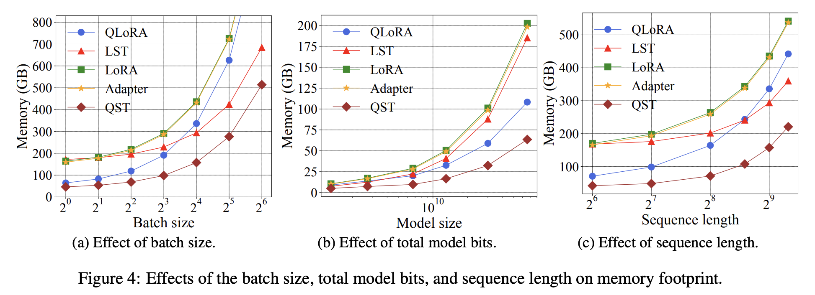

Slide 18
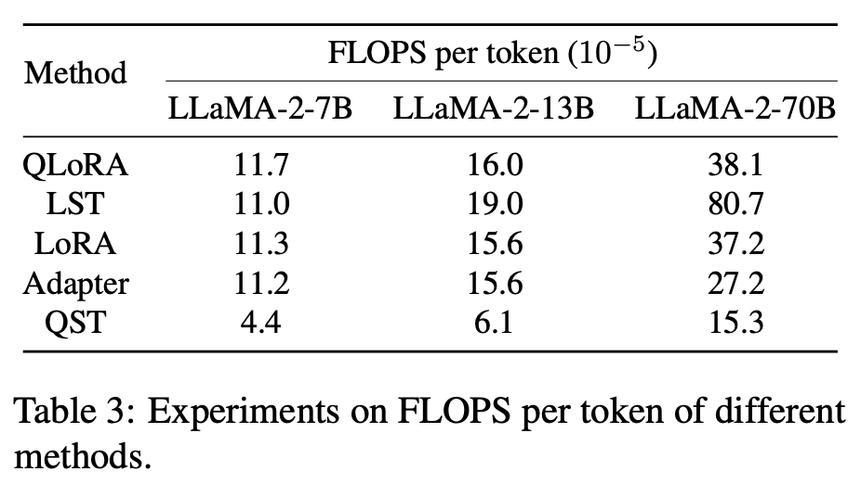
FLOPs per token stands for "Floating Point Operations per token." It is a metric used to measure the computational cost of processing each token (e.g., word, sub-word) in a sequence by a neural network model.

Slide 19
More?
LORA: LOW-RANK ADAPTATION OF LARGE LANGUAGE MODELS. https://arxiv.org/pdf/2106.09685
QLORA: Efficient Finetuning of Quantized LLMs. https://arxiv.org/pdf/2305.14314
Lst: Ladder side-tuning for parameter and memory efficient transfer learning. https://arxiv.org/pdf/2206.06522
LLM-FP4: 4-Bit Floating-Point Quantized Transformers. https://arxiv.org/pdf/2310.16836

